Slide 1

Team Name : DOMinators
Team Leader Name : Krish Vaghasia
Problem Statement : Chase the Cloud: Leveraging Diffusion Models for Cloud Motion Prediction using INSAT-3DR/3DS Imagery

Slide 2

Team Members
Team Leader: Name: Krish Vaghasia College: Nirma University | Team Member-1: Name: Nisarg Vashi College: Nirma University
Team Member-2: Name: Heli shah College: Nirma University | Team Member-3: Name: Hensi Patel College: Nirma University

Slide 3
Brief about the Idea:
Project K.A.L.A.M.- Cloud Motion Prediction System
(Knowledge-Augmented Learning with Atmospheric Metamodels)
A Multi-Modal, Physics-Informed, Diffusion-Powered AI for Satellite-Based Cloud Motion Forecasting, a novel hybrid architecture combining Physics-Informed Conditional Diffusion Models with multi-spectral spatio-temporal attention to predict cloud motion from INSAT-3DR/3DS imagery.
Combines Conditional Diffusion Models with Physics-Informed Neural Networks for realistic cloud motion forecasting.
Learns optimal permutations across VIS, IR1/IR2, SWIR, and WV to model vertical lift, moisture, thermal gradients and many different parameters.
Spatio-Temporal Attention that captures short-term transitions using multi-frame sequences with time-aware embeddings.
Self-Supervised Reinforcement that uses predicted vs actual residuals to adaptively fine-tune predictions post-deployment.
Helpful for high-resolution nowcasting, storm surge alerts, and extreme weather mitigation for the Indian subcontinent.

Slide 4
Opportunity should be able to explain the following:
USP of the proposed solution
Hybrid Physics-AI Core: Combines atmospheric dynamics via PINNs with probabilistic realism of DDPM.
Spectral Intelligence Engine: Learns permutation-dependent feature importances
e.g.,
WV + IR1 → moisture lift
VIS + SWIR → fog initiation
IR2 → vertical cloud top height
Self-Evolving Forecasting: Continuously adapts based on real-time feedback from downstream errors.
High Transferability: Pipeline can generalize to other EO tasks like precipitation prediction, dust storms, etc.
Deployment Ready: Works with IMD, ISRO protocols; designed for cloud-native, scalable rollouts.
How different is it from any of the other existing ideas?
Traditional methods like optical flow lack vertical/cloud physics awareness; CNN/LSTM models often ignore spectral context and causality.
Our architecture uniquely fuses:
Physics-Informed Neural Networks (PINNs) for meteorological grounding and practicality in predictions.
Custom Architecture for realistic cloud evolution and motion predictions based on multiple parameters.
Spectral Permutation Learning across INSAT bands (VIS, IR1/2, WV, SWIR)
First of its kind: Learns physical and spectral interdependencies across time in a generative framework.
How will it be able to solve the problem?
Our solution integrates 4–6 past multi-spectral INSAT frames (VIS, IR1/2, SWIR, WV) into a hybrid AI model combining Conditional Diffusion Networks, Physics-Informed Neural Networks (PINNs), and Graph Neural Networks (GNNs).
This enables realistic and physically consistent cloud motion forecasting. By learning spatio-temporal patterns and atmospheric dynamics like vertical uplift, moisture flow, and convection, the model generates 1-2 high-fidelity future frames (can be extended using our modular solution), empowering accurate 0–3 hour nowcasting, early warnings for severe weather, and scalable deployment for real-time meteorological intelligence.

Slide 5
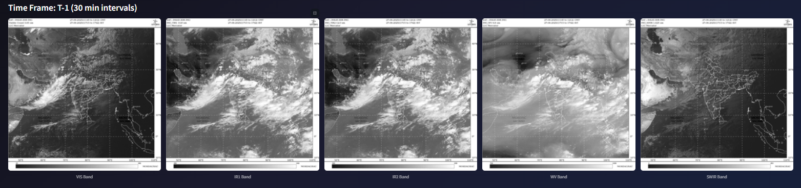
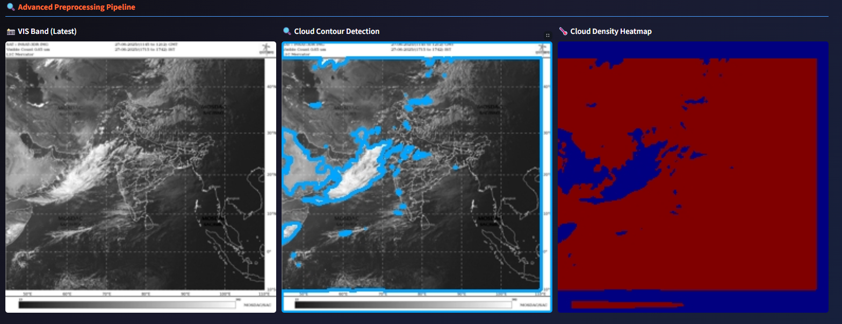
Features offered by the Solution:
Smart Multi-Band Preprocessing Pipeline Utilizes fine-tuned SAM2 for cloud segmentation, contour extraction, and heatmap generation across all 5 spectral bands of INSAT imagery.
Hybrid AI Model Architecture with Physics-Aware Learning Combines UNet, Conditional Diffusion, Graph Neural Networks (GNN), PiNN, and Autoencoder—ensuring both accuracy and physical consistency.
Adaptive Real-Time Learning Performs 4-frame batch retraining with continuous error feedback and self supervised learning to dynamically improve predictions in near real-time.
Feature-Aware Learning Pipeline Leverages permutation-dependent feature engineering for improved band-wise relevance understanding and selection.
High-Fidelity Forecasting with Interactive Web Interface Delivers two high-resolution, half-hour-ahead cloud forecasts with realistic animation and an intuitive web-based GUI for visual comparison against ground truth. The platform also enables on-screen evaluation using metrics like SSIM and PSNR and various forcasting parameters enhancing interpretability and user experience.
Raw ( 5 band images )
Preprocessed Images
*POC of our idea, developed on limited INSAT Data from MOSDAC (142 images)

Slide 6
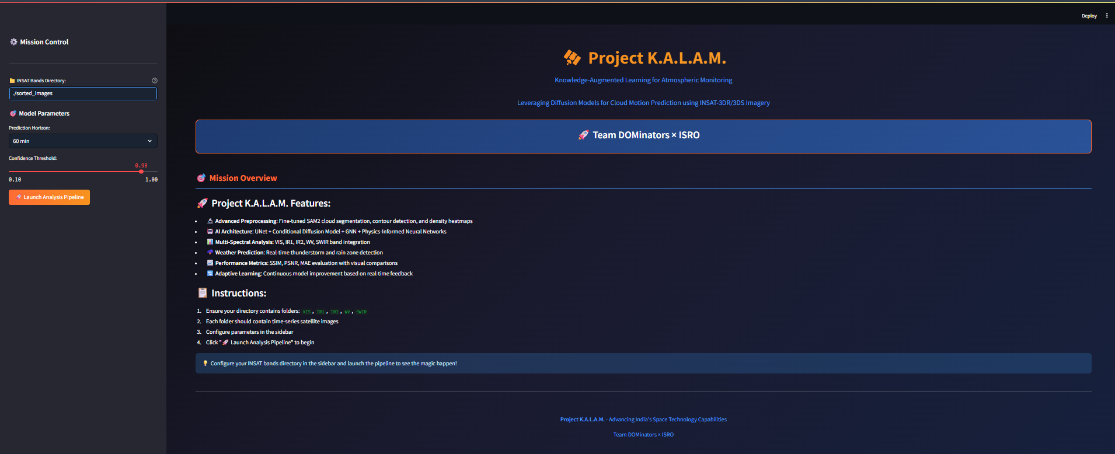
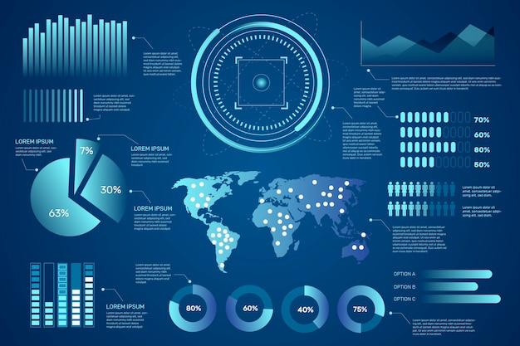


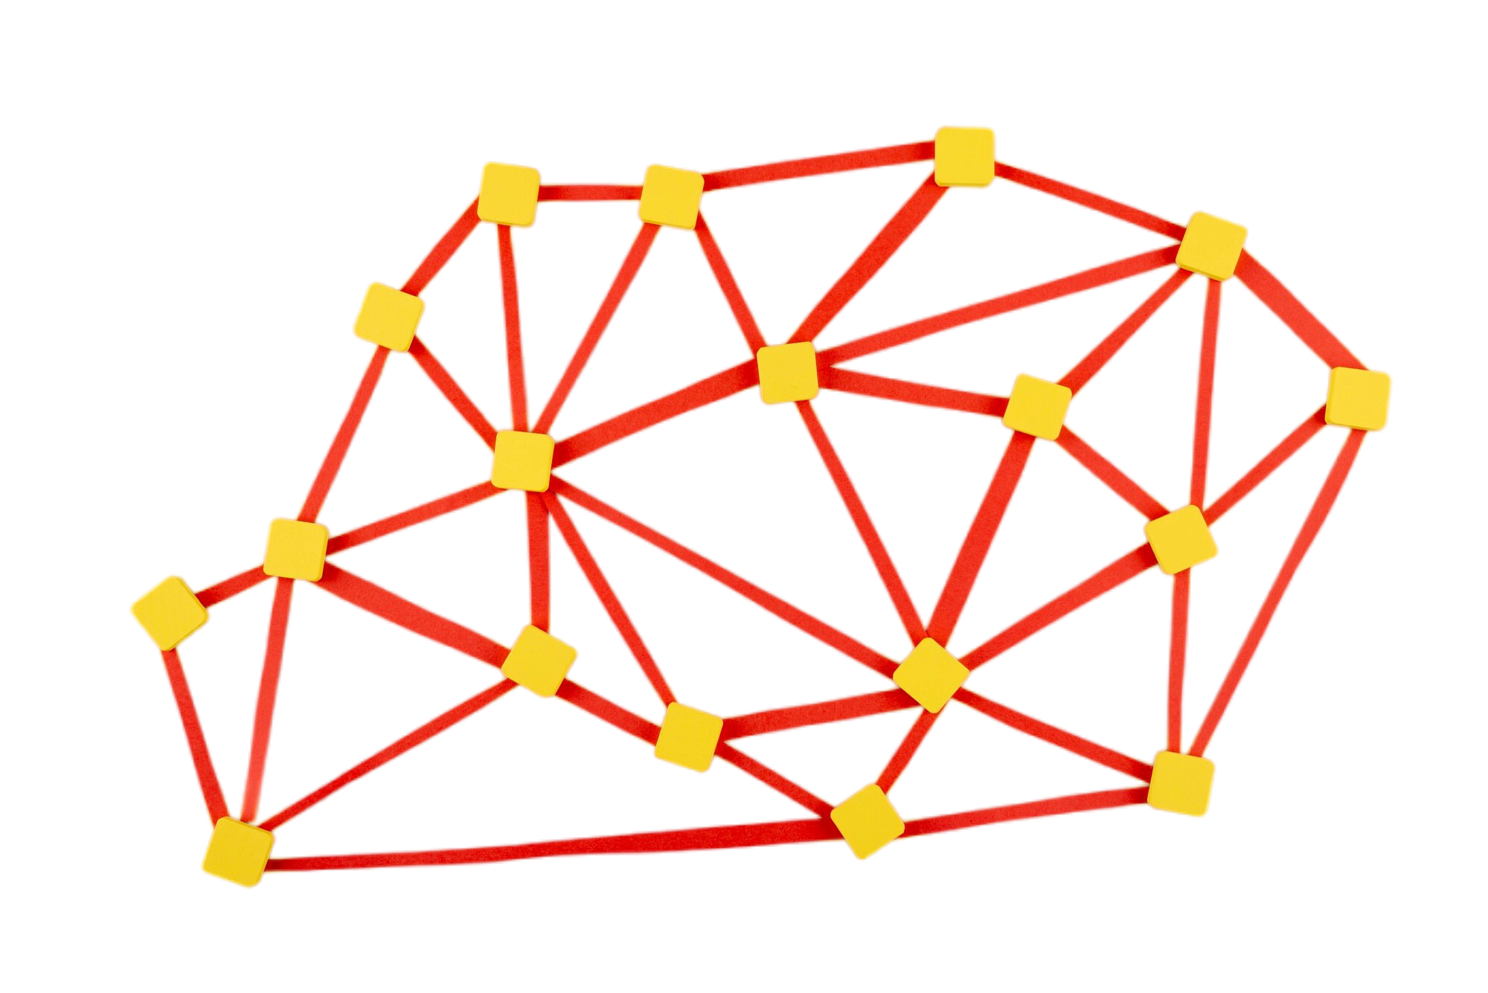

Process flow diagram
Dashboard
Input Frames
predicted
Satellite
actual
(POC)
Preprocessing Pipeline
Model
Architecture
Database
predicted
actual
Predicted Frames
Self Supervised Learning
* We will add a self supervised learning loop for better improvement in prediction and also helpful for anomaly detection

Slide 7
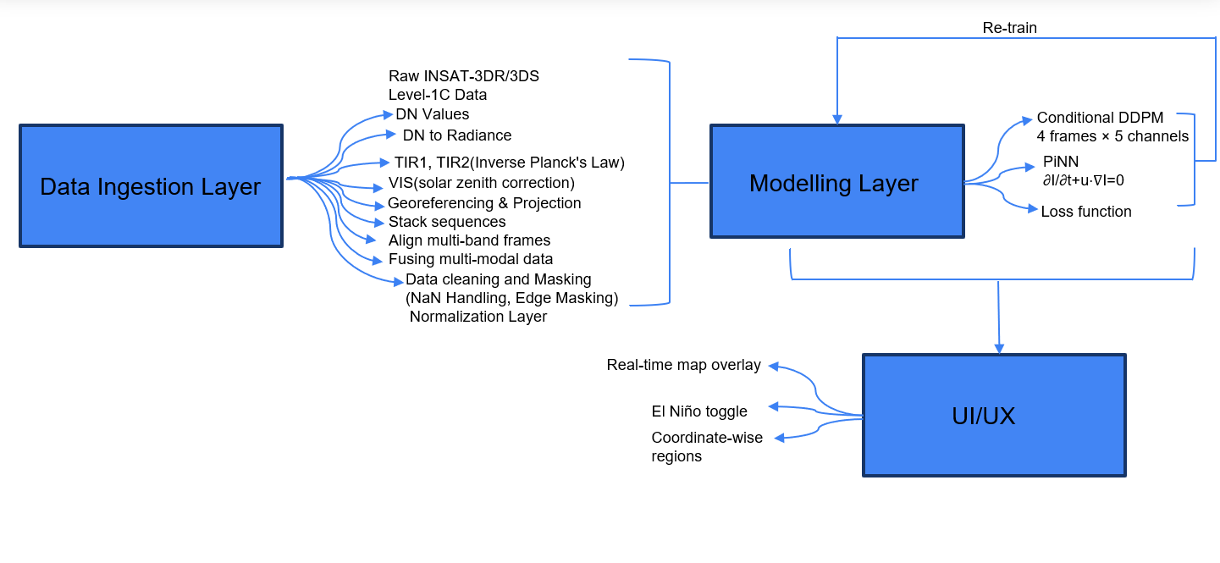
Wireframes/Mock diagrams of the proposed solution
Radiance | L=G⋅DN+BL | All
BT | Inverse Planck | TIR1, TIR2, WV
Albedo | πL/(E0cos⁡θ) | VIS
Cloud Height | (Tsfc−Tcloud)/Γ | TIR1
Split Window ΔT | TIR2−TIR1 | TIR1
Optical Depth | −ln⁡(1−A/1+A) | VIS
* We will predict various cloud motion parameters with the help of Data + Physics constraints

Slide 8
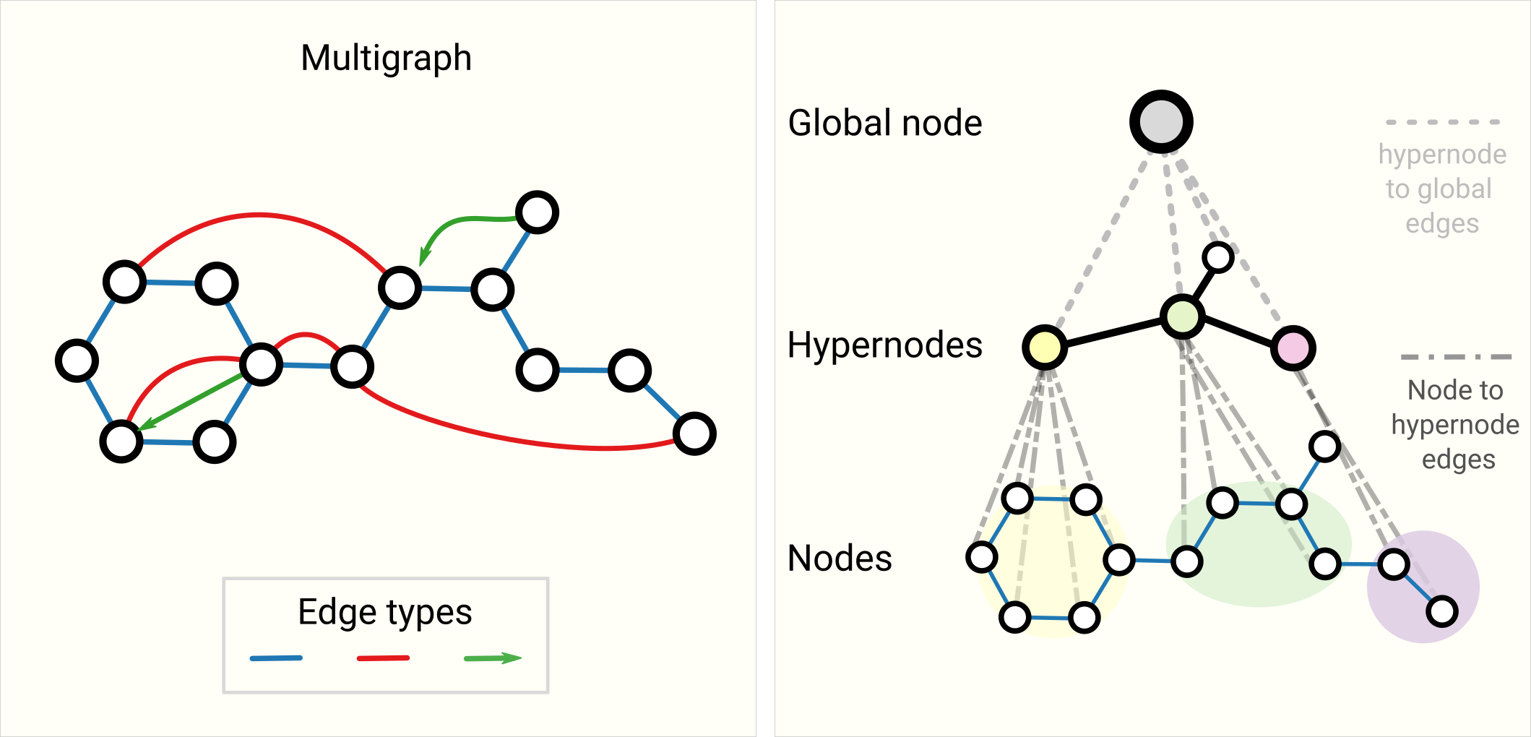
Architecture diagram of the proposed solution
Encoder
4–5 down- sampling blocks
Decoder
4–5 up-sampling blocks
Input Tensor Shape
Latent Bottleneck
Noise Scheduler
Reverse Denoising
Timestep Embedding
Conditioning
Conditional DDPM
Self-Supervised
Learning
PiNN Block
Ladv​=MSE.(∂I​/ ∂t +u.∂I/ ∂x ​+v. ∂I/ ∂y ​)
Temporal Positional Encoding
GNN
Anomaly Detection
*POC of our idea, developed on limited INSAT Data from MOSDAC (142 images)

Slide 9
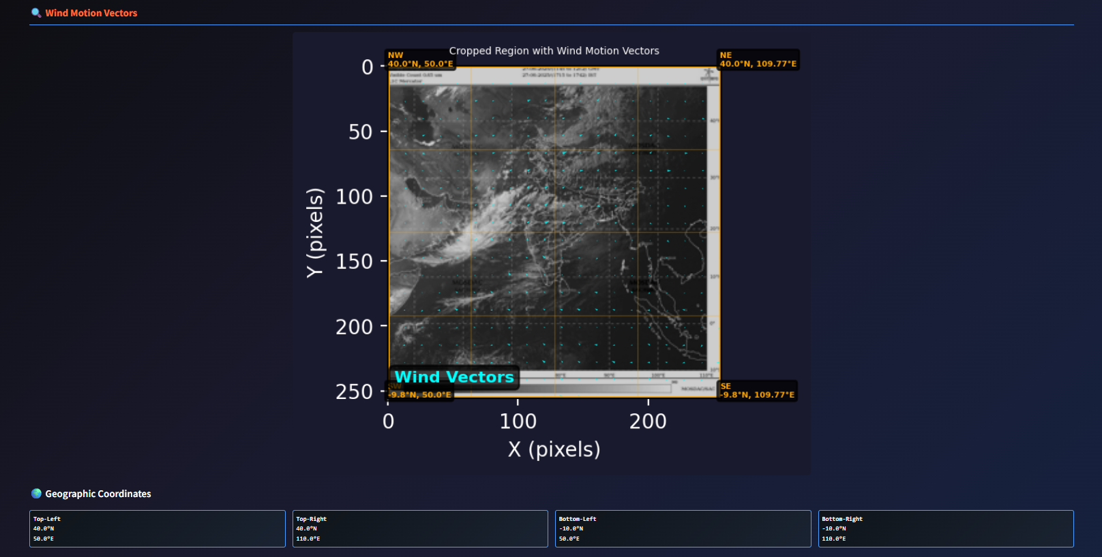
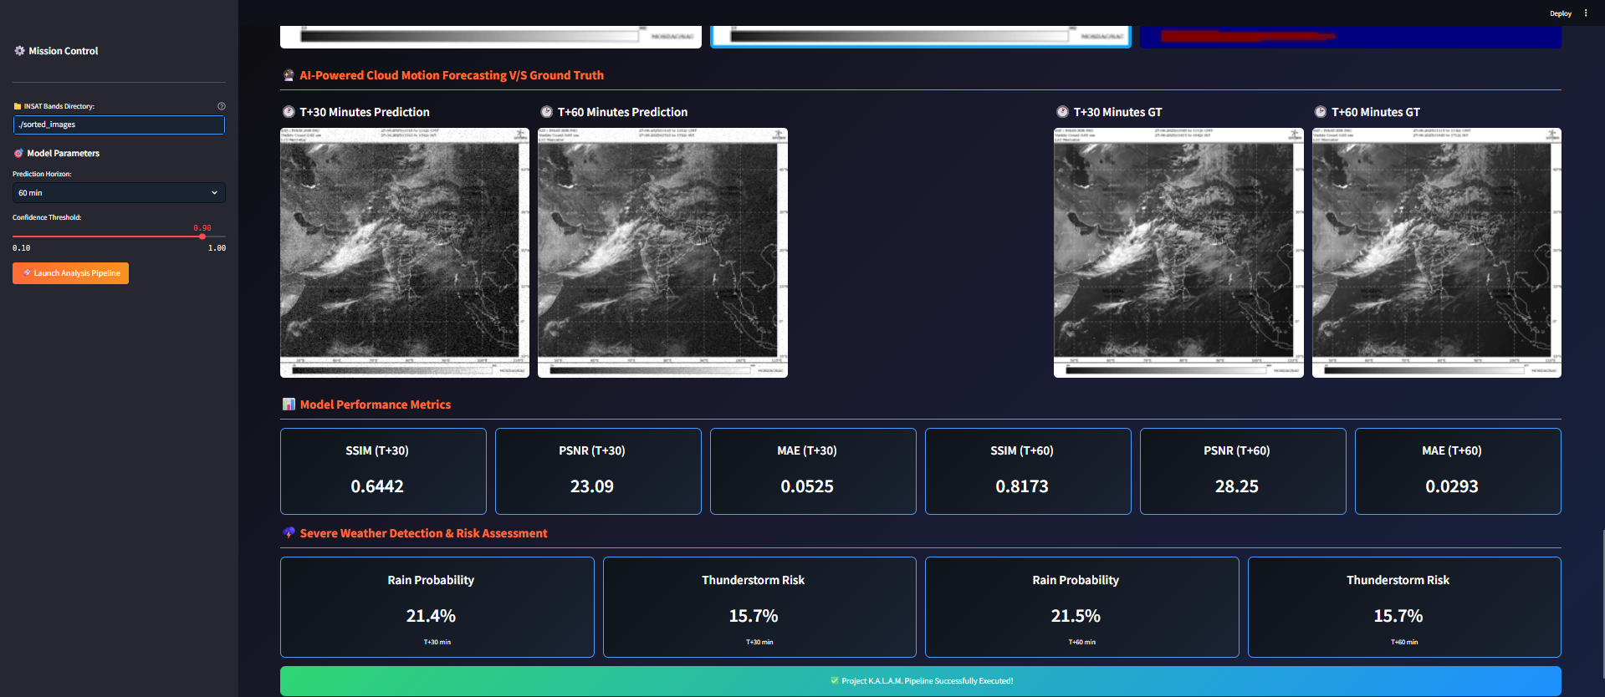
POC of Model Prototype
Tech Stack for K.A.L.A.M.
Modeling & Forecasting
PyTorch + PyTorch Lightning
Conditional Diffusion Models (DDPM),Physics-Informed Neural Networks (PINNs), Graph Neural Networks (GNNs)
Autoencoders, UNet
Data & Preprocessing
xarray, OpenCV, NumPy, Pandas
Fine-tuned SAM2, Scikit-image
Interface & Visualization
Streamlit (POC), Electron.js (cross-platform app)
React, MapboxGL.js
Plotly, Matplotlib
Backend
FastAPI, WebSockets
Redis, Postgres(PostGIS)
Deployment & Scaling
Docker,VPS Deployment
TensorBoard,TorchScript, ONNX
Wind Direction Predictions
Performance Matrices with Predictions

Slide 10
Estimated implementation cost :
FIXED COST (ONE-TIME SETUP):
Item | Cost (₹) | Description
Model Development (UNet + DDPM + PiNN + GNN) | ₹1,00,000 | Full AI pipeline development.
Preprocessing Engine + Self Supervised Fine tune | ₹70,000 | DN ➝ BT/Albedo + SAM2 segmentation & heatmap, and self supervised retrain.
Local GPU | ₹2,00,000 | Avoids recurring cloud GPU cost.
SAM2 Fine-Tune on INSAT | ₹30,000 | Run or reuse SAM2 weights, custom adapter.
Web UI + Visualization | ₹20,000 | UI for comparison, map overlay, metrics.
Database/API Layer Setup | ₹75,000 | Metadata tagging, ROI queries, ERA5 fetcher.
Documentation + SOP Handover | ₹60,000 | KT docs for NESAC/IMD.
SSL/Domain/Security Setup | ₹30,000 | Secure public endpoint deployment .
= ₹5,85,000 (Estimated Cost (may vary based on final deployment and resources.)

Slide 11
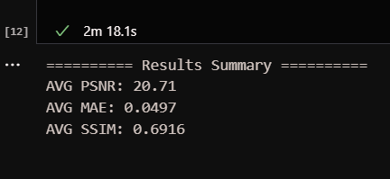
Team Roles
References
Krish Vaghasia (Team Leader)
Full Stack Developer
Heli Shah
AI/ML Developer
Hensi Patel
Backend Developer
Nisarg Vashi
AI/ML Developer
Research Papers:
-----------------------------------------------------------------------
Denoising Diffusion Probabilistic Models – Ho et al., 2020
Physics-Informed Neural Networks – Karniadakis et al., 2021
U-Net: Convolutional Networks for Biomedical Image Segmentation – Ronneberger et al., 2015
Segment Anything Model (SAM) – Kirillov et al., 2023
Convolutional LSTM for Precipitation Nowcasting – Shi et al., 2015
Graph Networks as Learnable Physics Engines – Battaglia et al., 2018
Physics-Informed Weather Forecasting – Chattopadhyay et al., 2021
Deep Learning for Remote Sensing: A Survey – Khan et al., 2022
Graph Networks as Learnable Physics Engines – Battaglia et al., 2018
Other:
-----------------------------------------------------------------------
ISRO INSAT-3DR/3DS L1C Data User Manuals
ERA5 Atmospheric Reanalysis (ECMWF)
NOAA Oceanic Niño Index (ONI)
IMD Nowcasting Guidelines & SOPs
Results
We, as a dedicated team, are excited to solve this problem and actively contribute to India’s AI vision .

Slide 12


